Slide 1
Convolutional Neural Networks

Slide 2
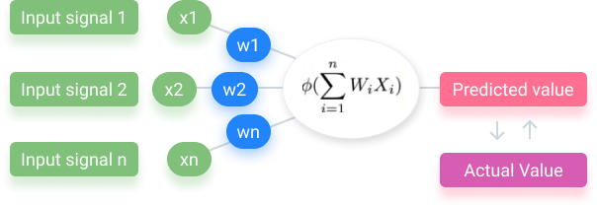
ANN

Slide 3
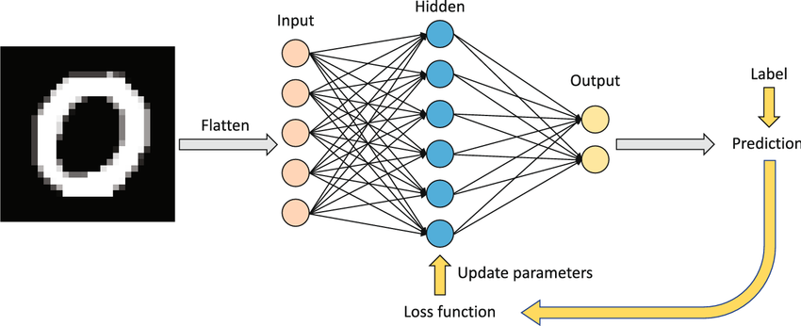
ANN for Image Data

Slide 4
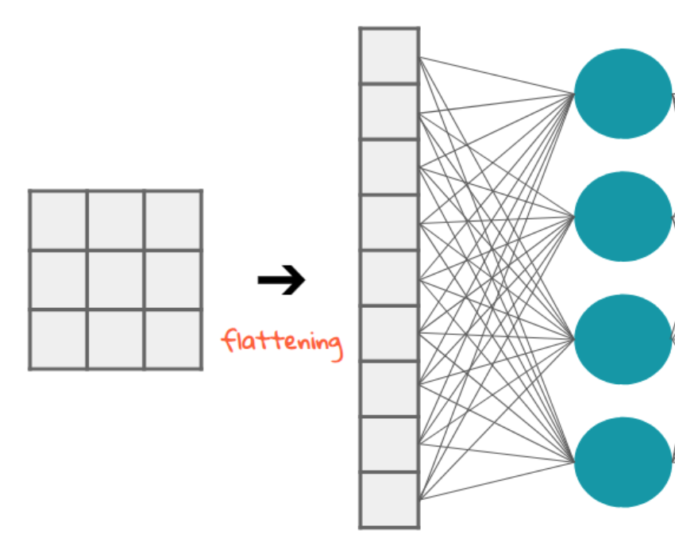
ANN for Image Data

Slide 5
ANN: Challenges
High dimensionality: As the resolution and number of channels increase, the dimensionality grows exponentially. This high dimensionality can lead to Vanishing Gradient and Overfitting.
Computational cost: The large number of parameters (weights and biases) in the network and the high dimensionality of the data require significant computational resources and processing power.
Preserving Spatial Relationships: Fully-connected networks, struggle to inherently capture the spatial relationships between pixels in an image. These networks treat each pixel independently, potentially losing valuable information about the relative positions and arrangements of features within the image.

Slide 6
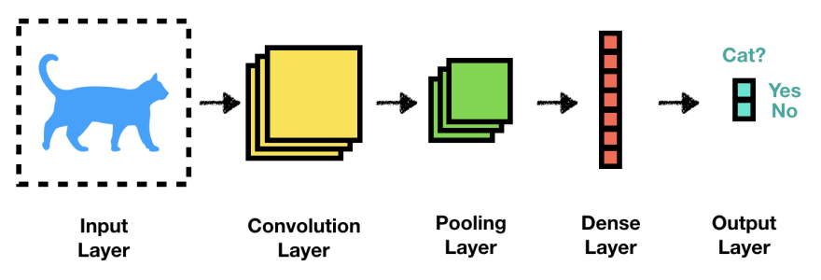
CNN

Slide 7
CNN
Unlike standard ANNs that treat each pixel independently, CNNs leverage convolutional layers to capture spatial relationships between pixels. These layers employ filters (kernels) that slide across the image, analyzing small regions at a time. Each filter detects specific features, like edges, lines, or shapes. As the filters move across the image, they generate feature maps that highlight the presence and location of these features.
Pooling layers follow convolutional layers, downsampling the feature maps and reducing their dimensionality while preserving the most important information

Slide 8
CNN: Convolution

Slide 9
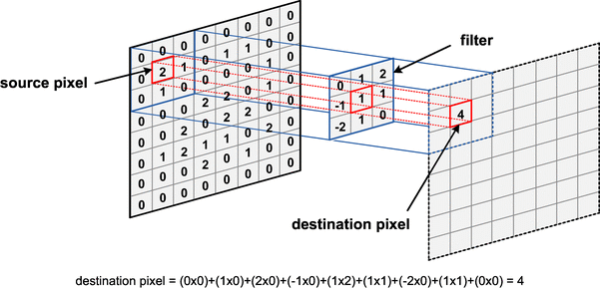
CNN: Convolution

Slide 10
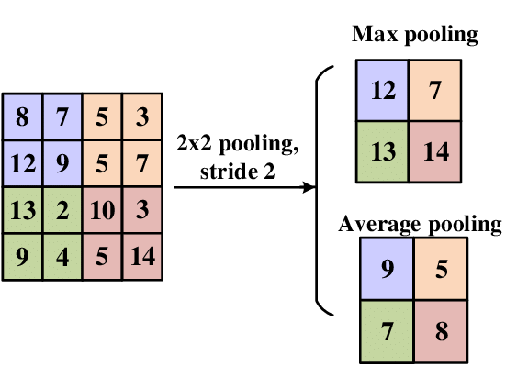
CNN: Pooling

Slide 11
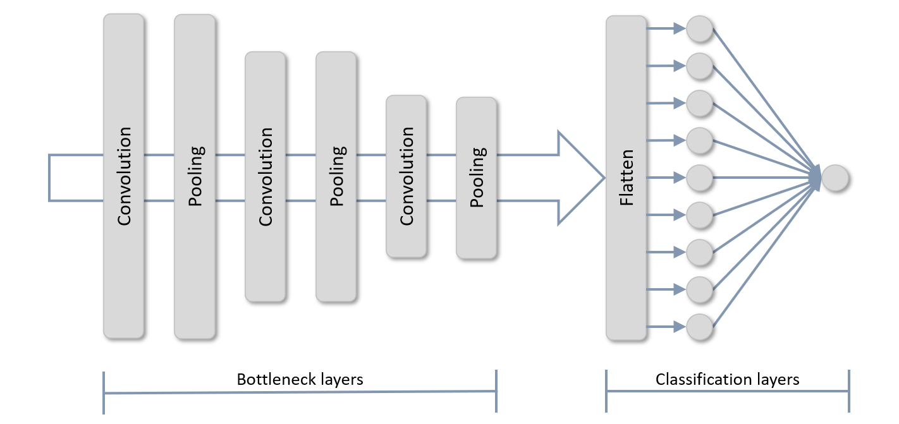
CNN: Classification

